Slide 1
Resolution predicate
Campean tudor ALEXANDRU

Slide 2
Exercise 2 Are the literals from the following pairs unifiable? If yes, find their most general unifier. X, y, z ∈ Var a,b ∈ Const f,g ∈ f1 h ∈ f2 p ∈ p3

Slide 3
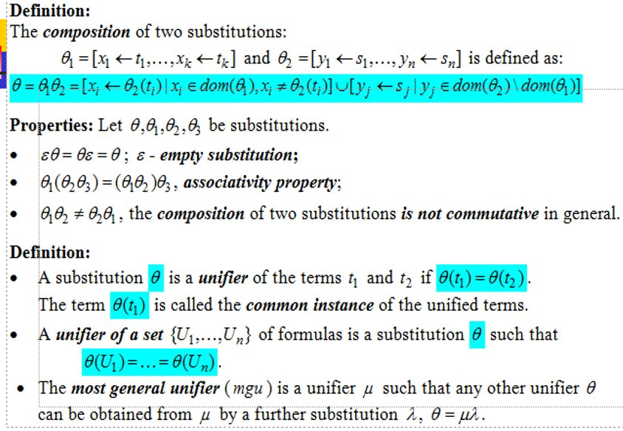

Slide 4
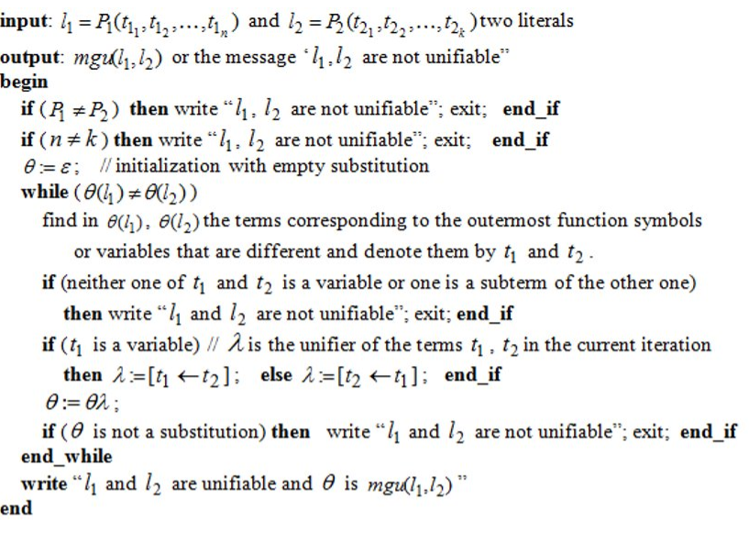

Slide 5
L1 = p(a, x, f(g(y))) l2 = P(Y,F(Z),F(Z))
⊖ = ε
⊖(l1) = P(a,x,f(g(y)))
⊖(l2) = P(y,f(z),f(z))

Slide 6
⊖(l1) = P(a,x,f(g(y))) ⊖(l2) = P(y,f(z),f(z))
First iteration:
lambda:= [y ← a] // the unifier for y and a
⊖:= ⊖lambda = [y ← a]
⊖(l1) =P(a,x,f(g(a)))
⊖(l2) = P(a,f(z),f(z))

Slide 7
⊖(l1) =P(a,x,f(g(y))) ⊖(l2) = P(a,f(z),f(z))
Second iteration:
lambda:= [x ← f(z)] // the unifier for x and f(z)
⊖:= ⊖lambda = [y ← a] [x ← f(z)]
= [ y ← a, x ← f(z)]
⊖(l1) =P(a,f(z),f(g(a)))
⊖(l2) = P(a,f(z),f(z))

Slide 8
⊖(l1) =P(a,f(z),f(g(y))) ⊖(l2) = P(a,f(z),f(z))
Third iteration:
lambda:= [z ← g(a)] // the unifier for z and g(a)
⊖:= ⊖lambda = [y ← a,x ← f(z)][z←g(a)]
= [ y ← a, x ← f(g(a)),z ← g(a)] = mgu(l1,l2)
Since we got ⊖(l2) = ⊖(l1) = P(a,f(g(a)),f(g(a))) it’s the common instance of l1 and l2

Slide 9
L1 = p(x,g(f(a)),f(b) l2 = P(F(y),z,z)
⊖ = ε
⊖(l1) = P(x,g(f(a)),f(b)
⊖(l2) = P(f(y),z,z)

Slide 10
⊖(l1) = P(x,g(f(a)),f(b) ⊖(l2) = = P(f(y),z,z)
First iteration:
lambda:= [x ← f(y)] // the unifier for x and f(y)
⊖:= ⊖lambda = [x ← f(y)]
⊖(l1) =P(f(y),g(f(a)),f(b))
⊖(l2) = P(f(y),z,z)

Slide 11
⊖(l1) =P(f(y),g(f(a)),f(b)) ⊖(l2) = P(f(y),z,z)
Second iteration:
lambda:= [z ← g(f(a))] // the unifier for z and g(f(a))
⊖:= ⊖lambda = [x ← f(y), z ← g(f(a))]
⊖(l1) =P(f(y),g(f(a)),f(b))
⊖(l2) = P(f(y),g(f(a)),g(f(a)))

Slide 12
⊖(l1) =P(f(y),g(f(a)),f(b)) ⊖(l2) = P(f(y),g(f(a)),g(f(a)))
Third iteration:
The terms f(b) and g(f(a)) are not unifiable since none of them is a variable, therefore we can conclude that the literals l1 and l2 are not unifiable!

Slide 13
L1 = p(a,x,f(g(y))) l2 = P(z,h(z,u),f(b))
⊖ = ε
⊖(l1) = P(a,x,f(g(y)))
⊖(l2) = P(z,h(z,u),f(b))

Slide 14
⊖(l1) = P(a,x,f(g(y))) ⊖(l2) = P(z,h(z,u),f(b))
First iteration:
lambda:= [z ← a] // the unifier for z and a
⊖:= ⊖lambda = [z ← a]
⊖(l1) =P(a,x,f(g(y)))
⊖(l2) = P(a,h(a,u),f(b))

Slide 15
⊖(l1) =P(a,x,f(g(y))) ⊖(l2) = P(a,h(a,u),f(b))
Second iteration:
lambda:= [x ← h(a,u)] // the unifier for x and h(a,u)
⊖:= ⊖lambda = [z ← a, x ← h(a,u)]
⊖(l1) =P(a,h(a,u),f(g(y)))
⊖(l2) = P(a,h(a,u),f(b))

Slide 16
⊖(l1) =P(a,h(a,u),f(g(y))) ⊖(l2) = P(a,h(a,u),f(b))
Third iteration:
b is a constant and g(y) is a function, therefore the terms can’t be unifiable. We conclude that the literals l1 and l2 are not unifiable!

